Slide 1
Cloud Computing With Azure
Course: AZ-900 Azure Fundamentals

Slide 2
Agenda
Code
SDLC
Game -> PubG

Slide 3
Day 1: Agenda
Scenario before cloud computing
What is cloud computing?
Scenario after cloud computing
One real time example
Example of cloud computing
Types of cloud computing( service and deployment model)
Capex & Opex
What is Microsoft azure?
Microsoft azure services
Steps for creating a Azure Account
Ways of accessing Microsoft Azure
Azure Subscriptions
Azure resource groups
Azure subscriptions and resources
Companies who use Azure

Slide 4
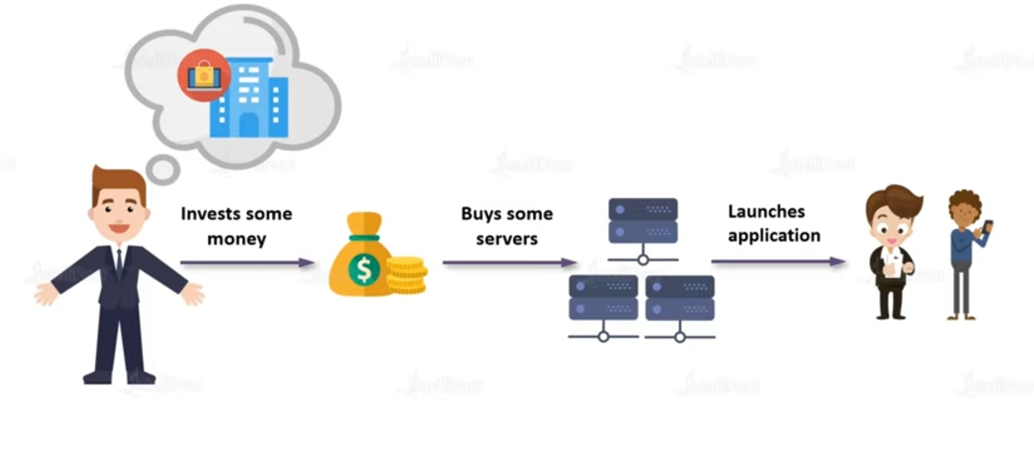
Before Cloud Computing

Slide 5
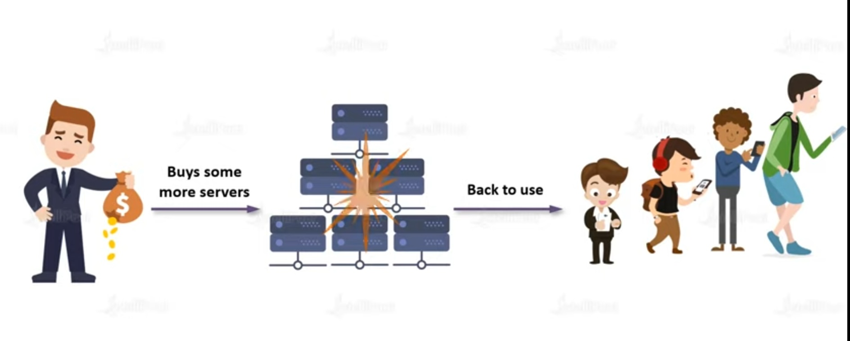

Slide 6
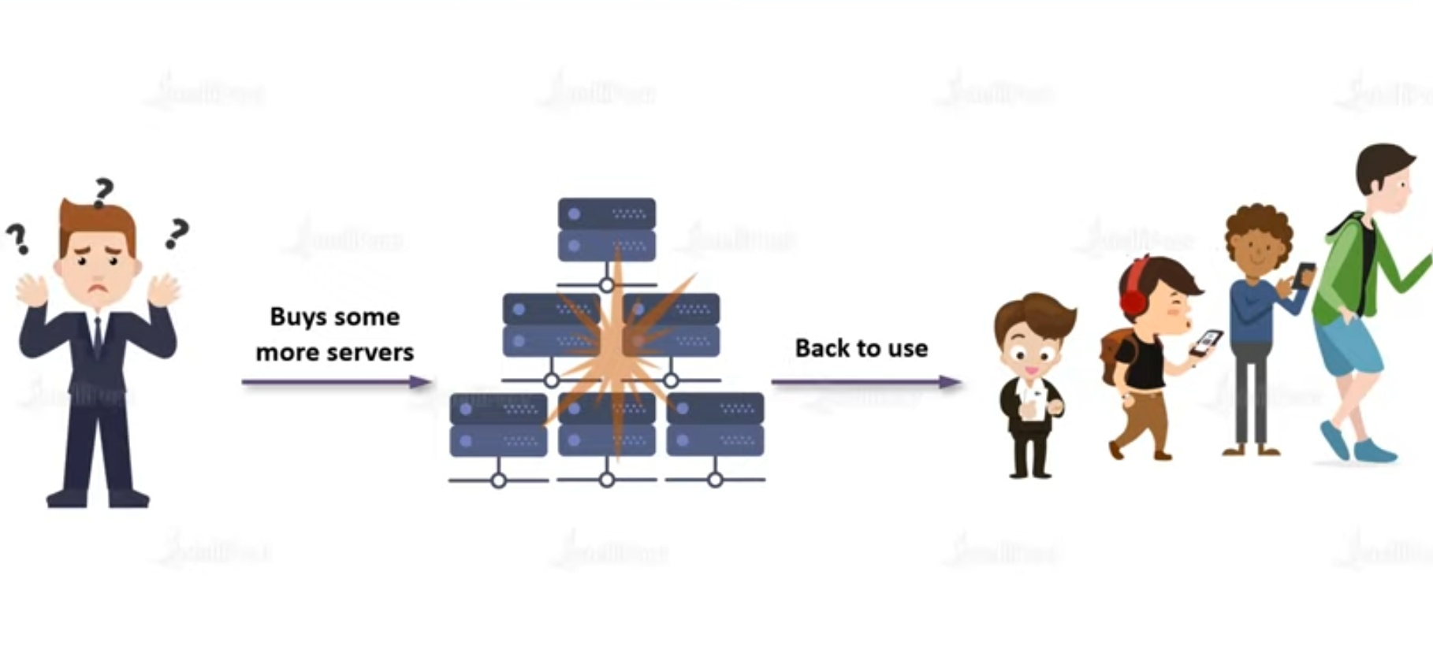

Slide 7
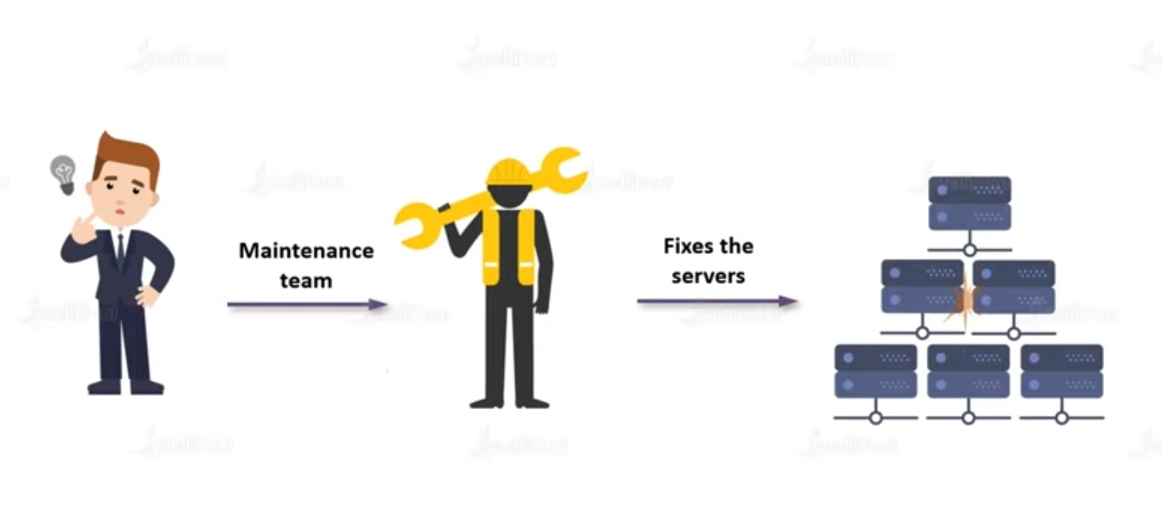

Slide 8
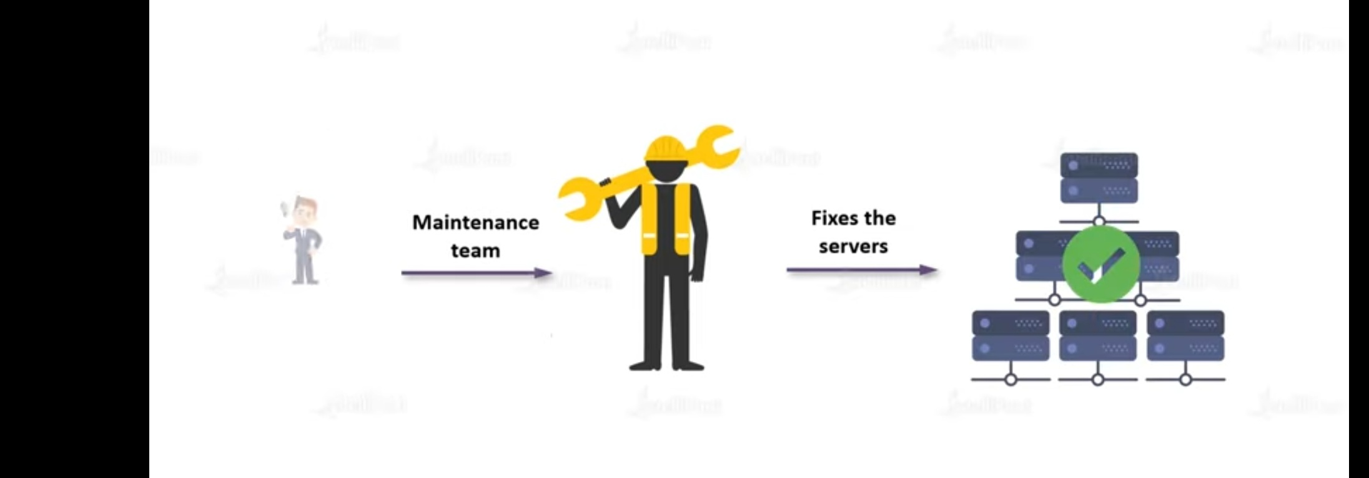

Slide 9
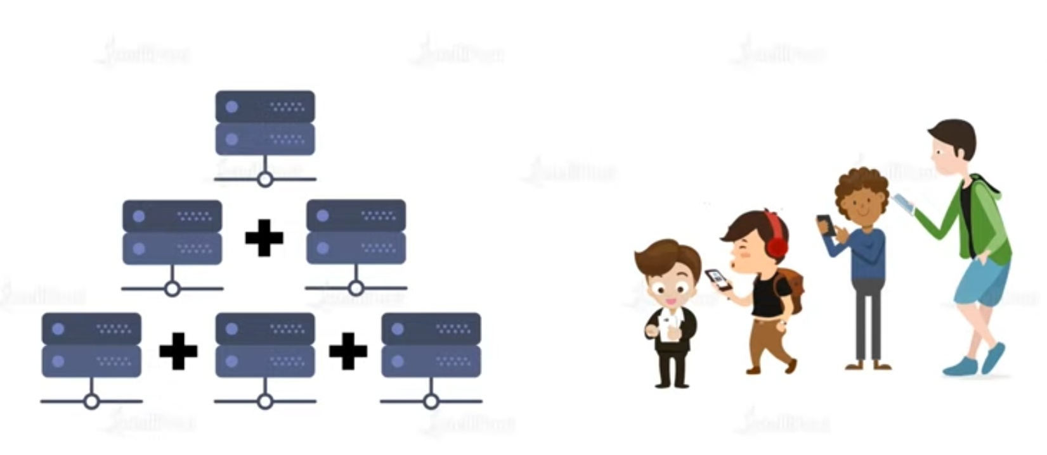

Slide 10
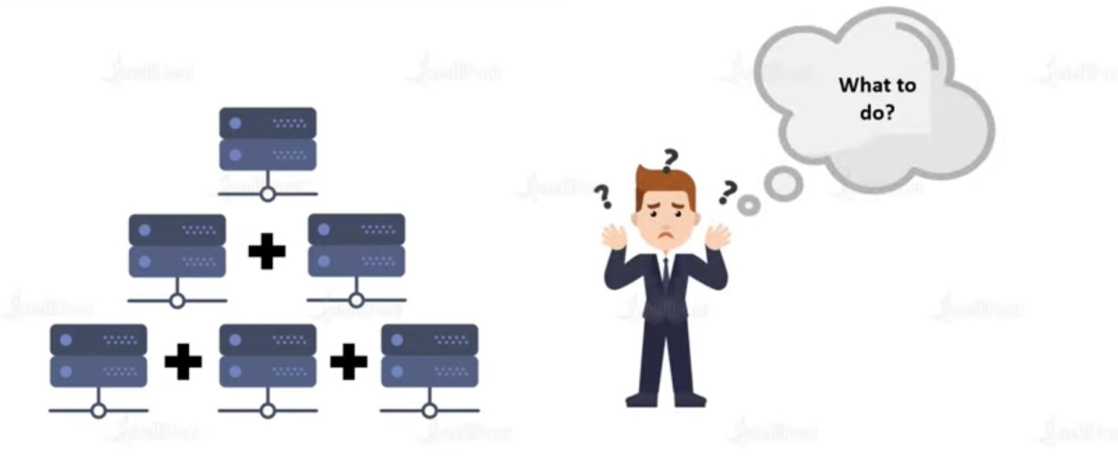

Slide 11
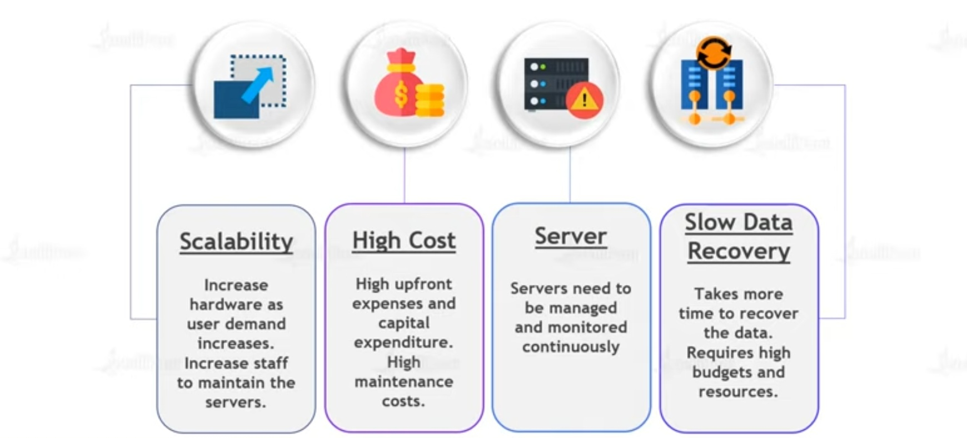

Slide 12
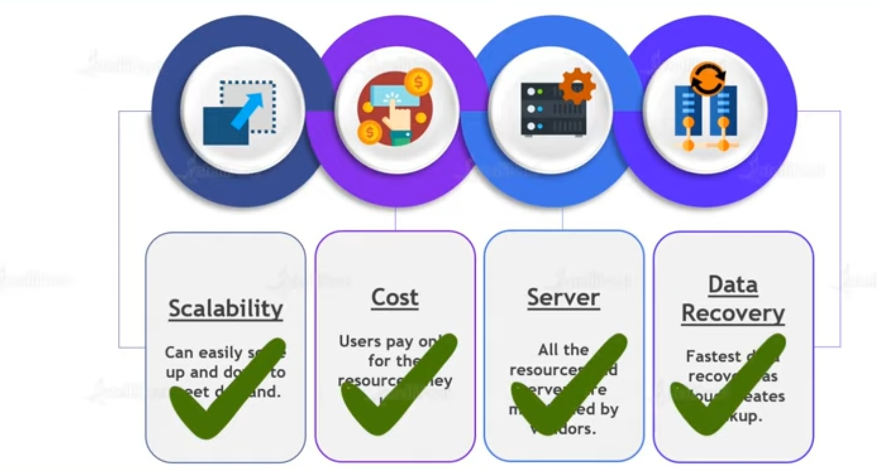
Scenario after cloud computing

Slide 13
What is cloud computing
"Cloud is about how you do computing, not where you do computing," goes a popular refrain in the domain of modern computing.
Cloud computing is the delivery of computing services like servers,storage,databases,networking,software,analytics, intelligence and more over the internet to offer faster innovation,flexible resources and economies of scale.
CC is basically accessing and using various computing services and resources via the internet

Slide 14
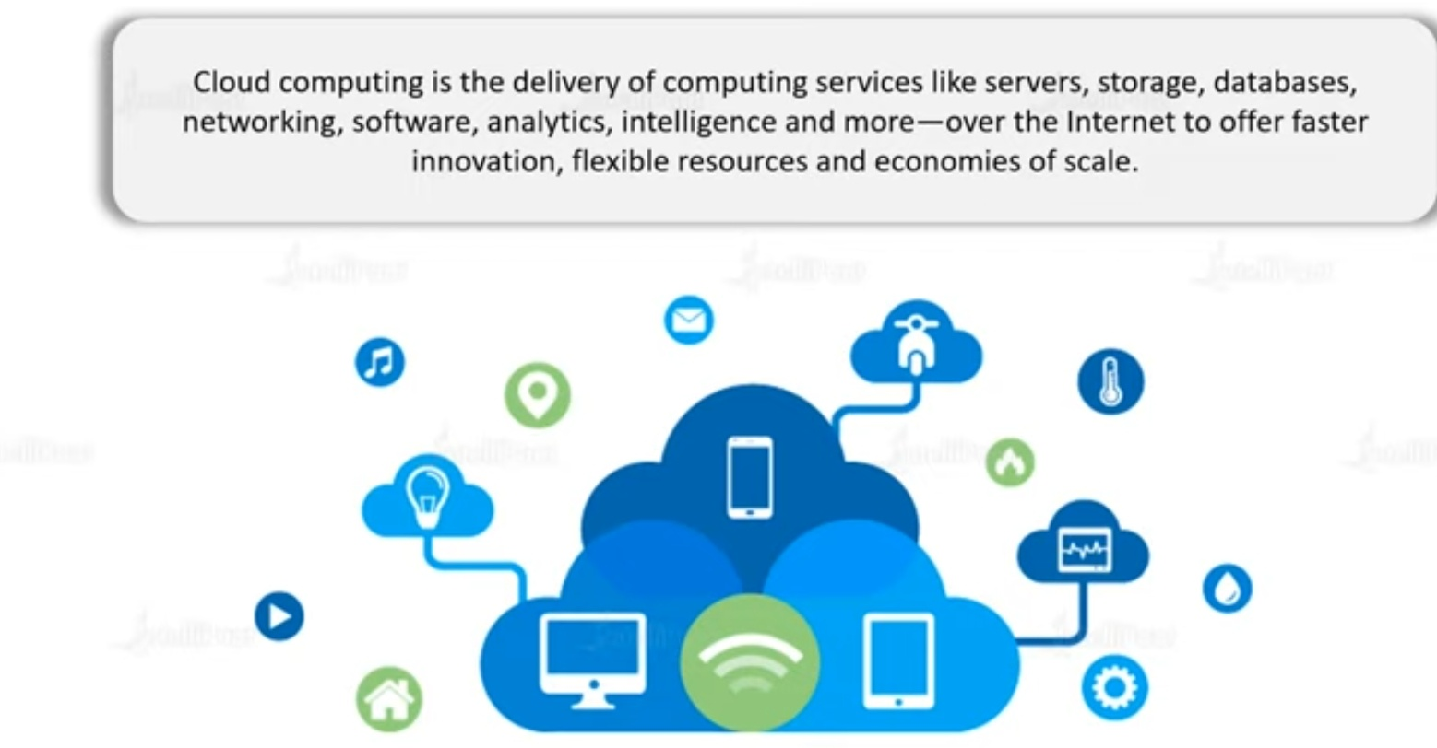

Slide 15
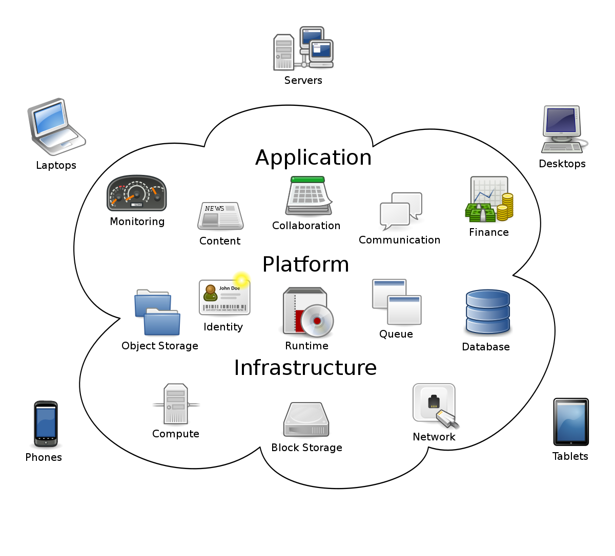

Slide 16


Slide 17
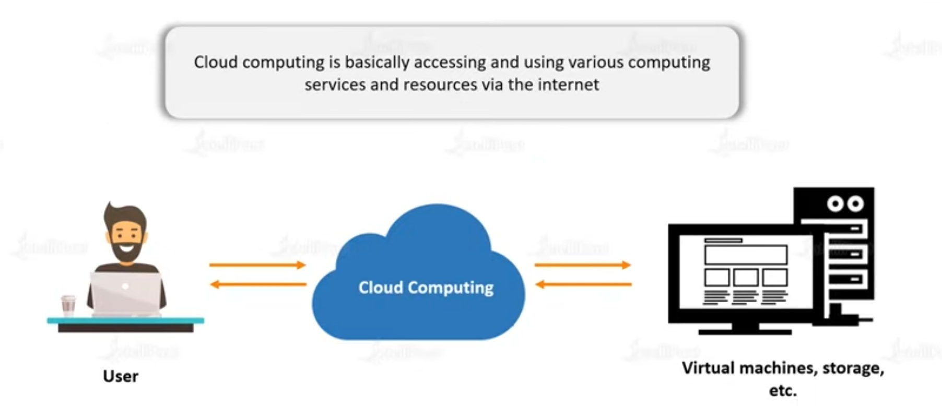

Slide 18
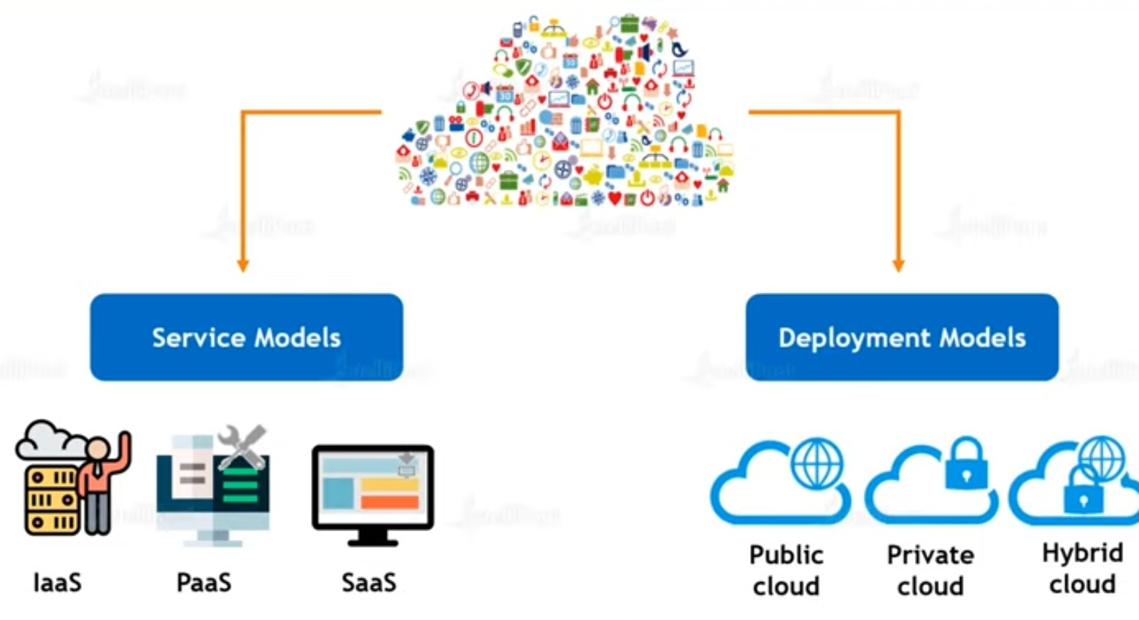
Types of cloud computing

Slide 19
1: Service model
IaaS -> infrastructure as a service
SaaS -> software as a service
PaaS -> platform as a service

Slide 20
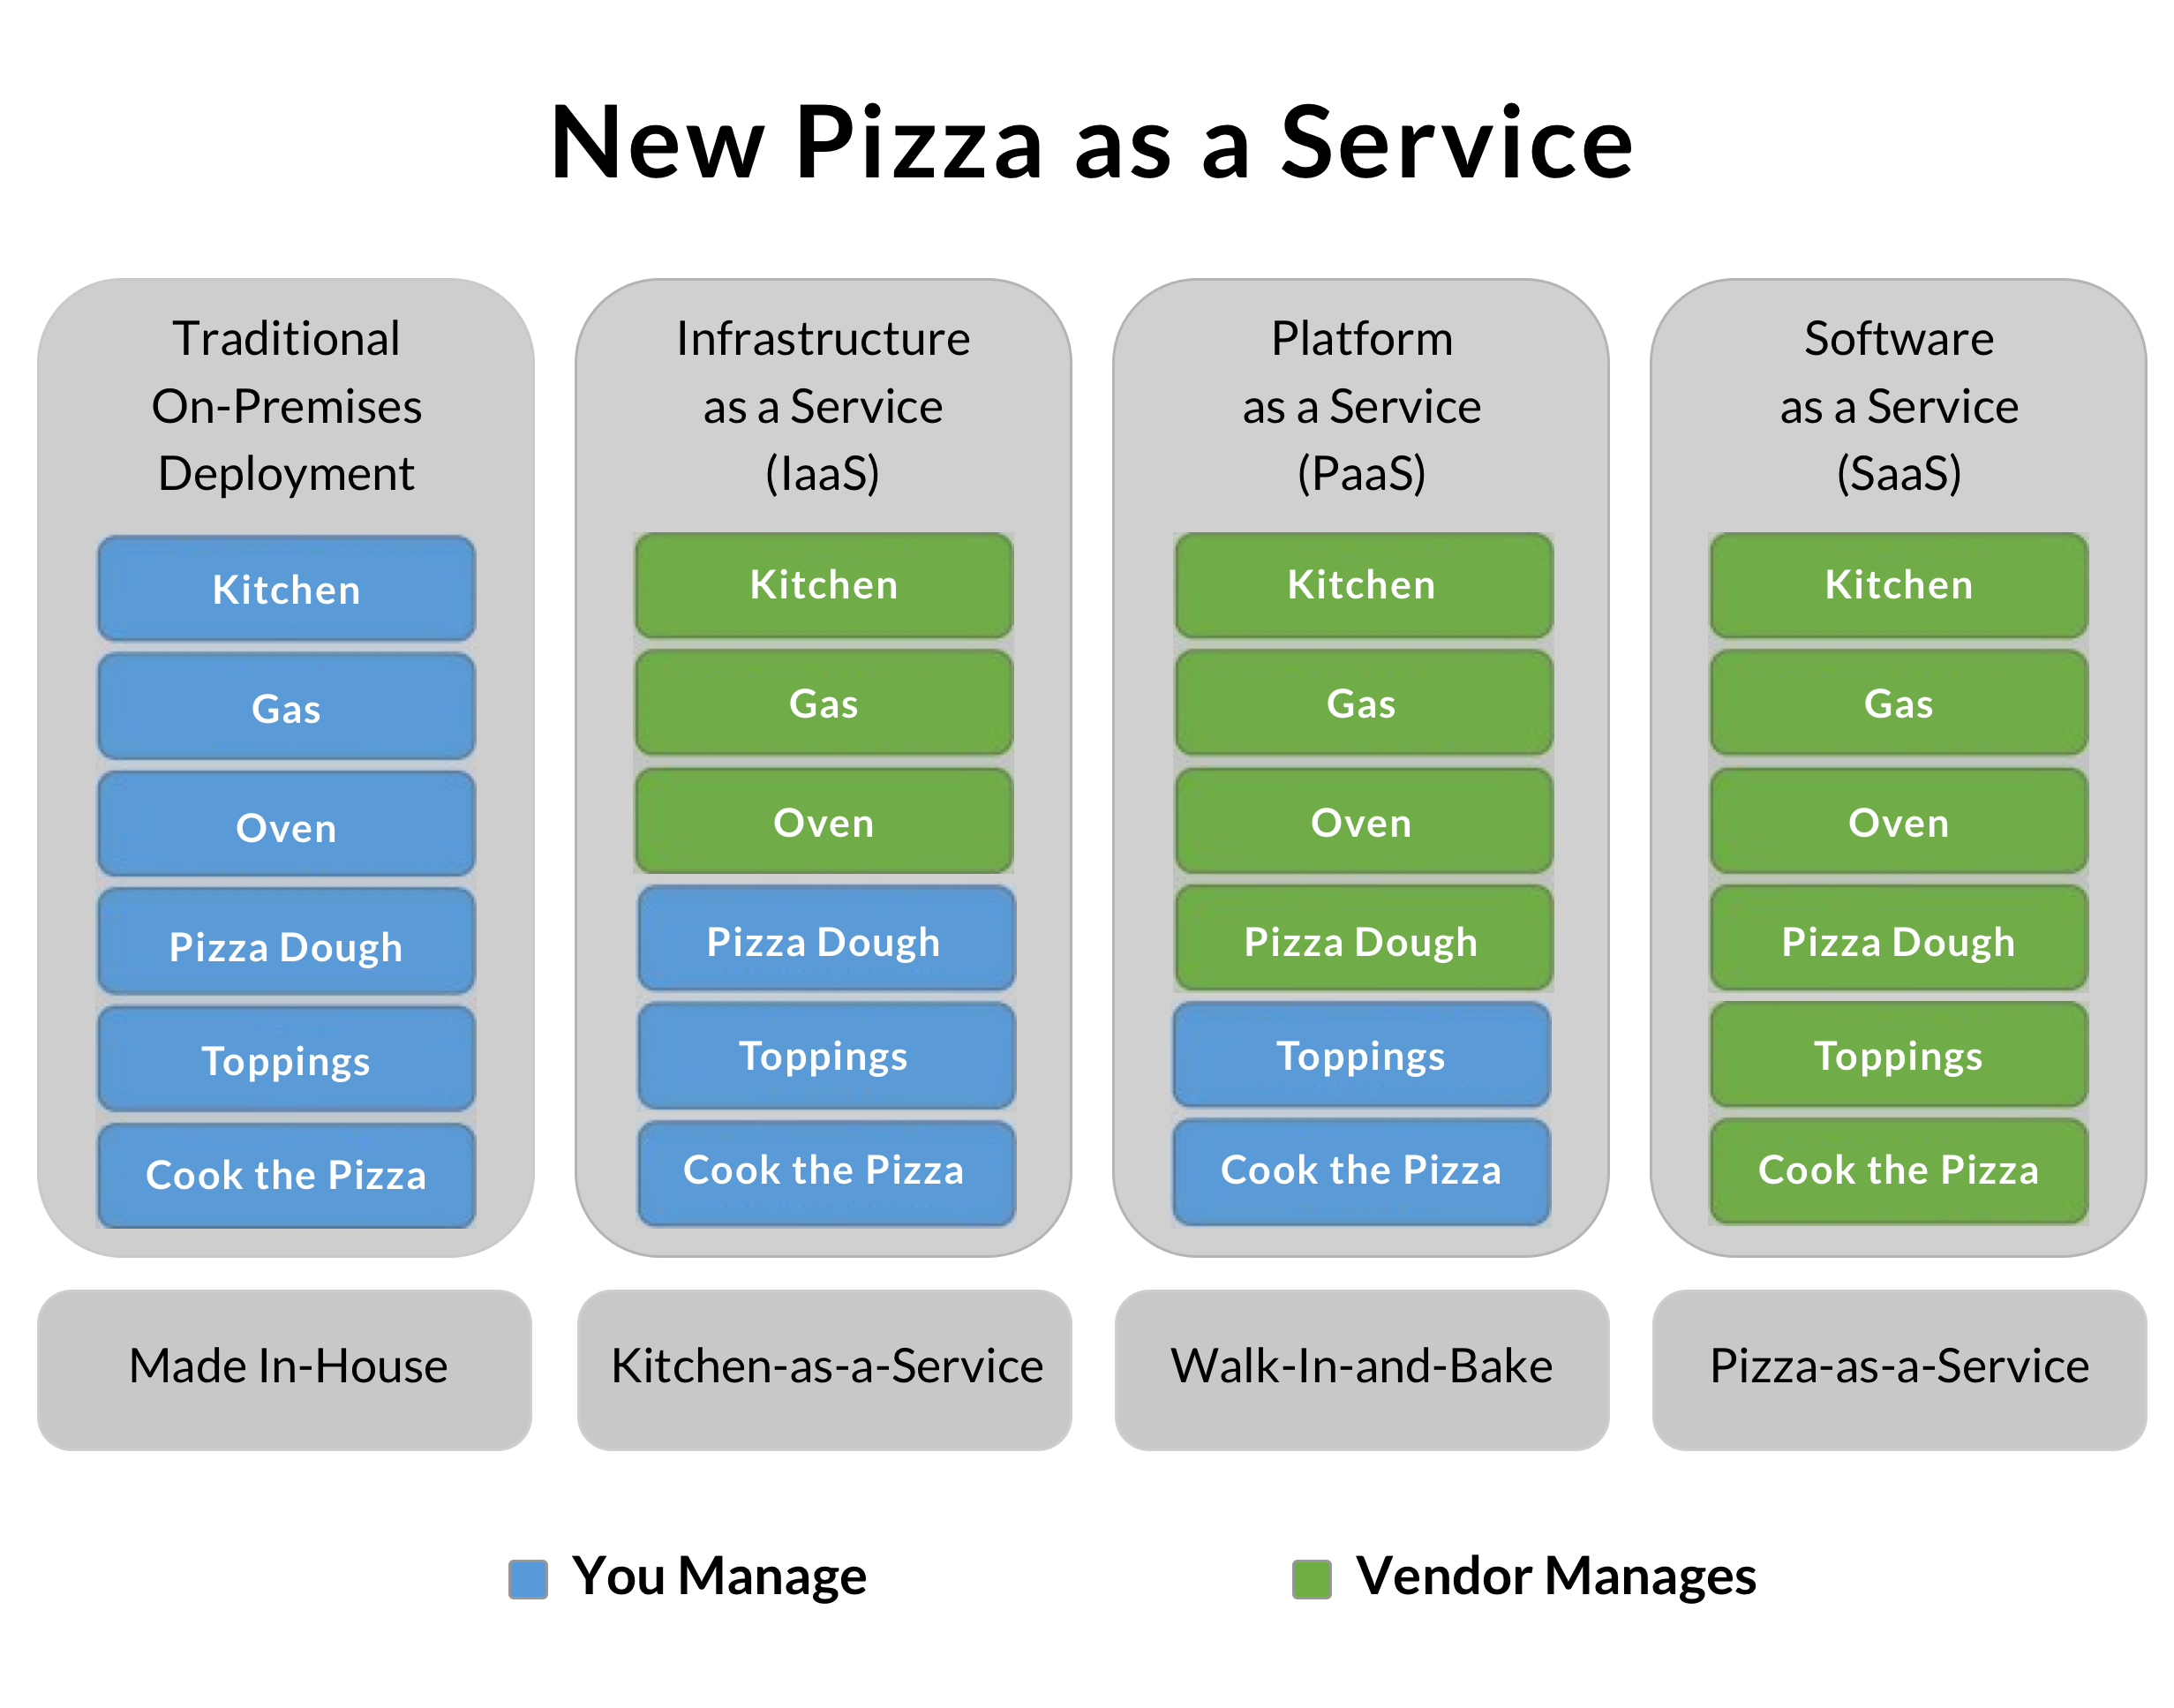
Example:

Slide 21
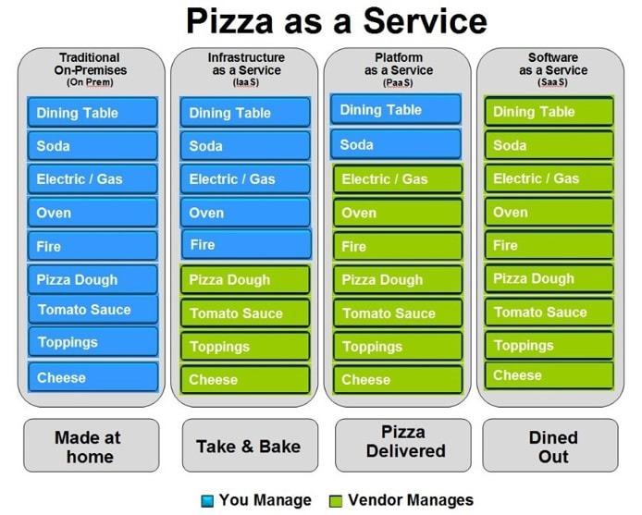

Slide 22
IaaS (Infrastructure as a Service), as the name suggests, provides you the computing infrastructure, physical or (quite often) virtual machines and other resources like virtual-machine disk image library, block and file-based storage, firewalls, load balancers, IP addresses, virtual local area networks etc.
Examples: Amazon EC2, Windows Azure, Rackspace, Google Compute Engine.
PaaS (Platform as a Service), as the name suggests, provides you computing platforms which typically includes operating system, programming language execution environment, database, web server etc.
Examples: AWS Elastic Beanstalk, Windows Azure, Heroku, Force.com, Google App Engine, Apache Stratos.
While in SaaS (Software as a Service) model you are provided with access to application software often referred to as "on-demand software". You don't have to worry about the installation, setup and running of the application. Service provider will do that for you. You just have to pay and use it through some client.
Examples: Google Apps, Microsoft Office 365.

Slide 23
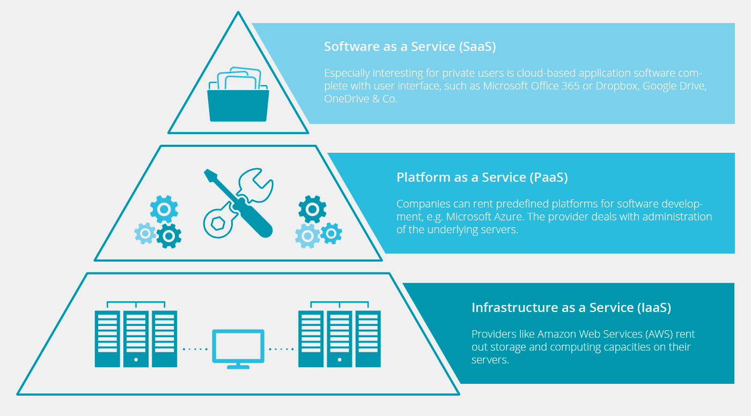

Slide 24
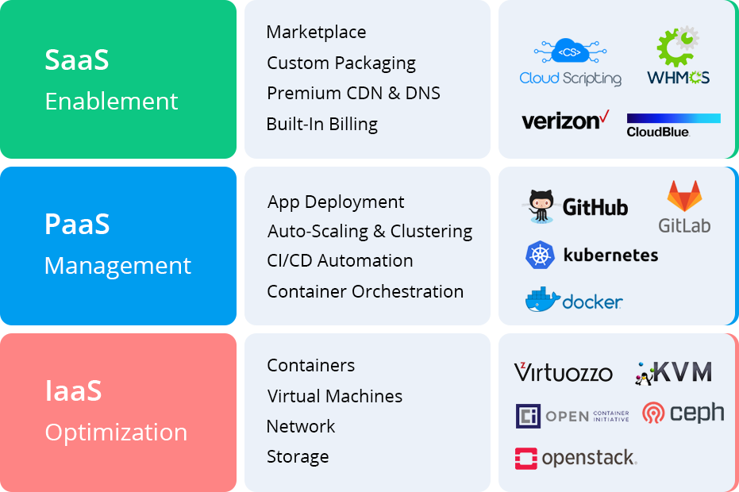

Slide 25
Q & A
Is Gmail IaaS or PaaS?
Is Netflix a SaaS?

Slide 26
2: Deployment model
Public
private
hybrid

Slide 27
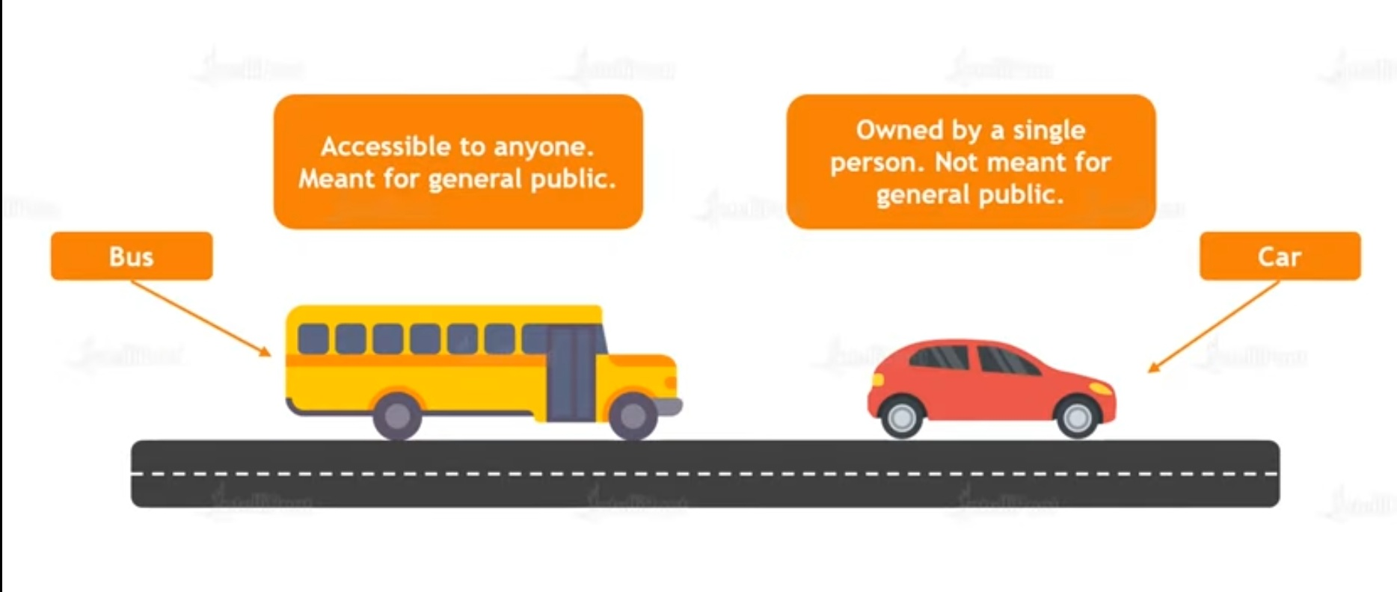
Public & Private

Slide 28
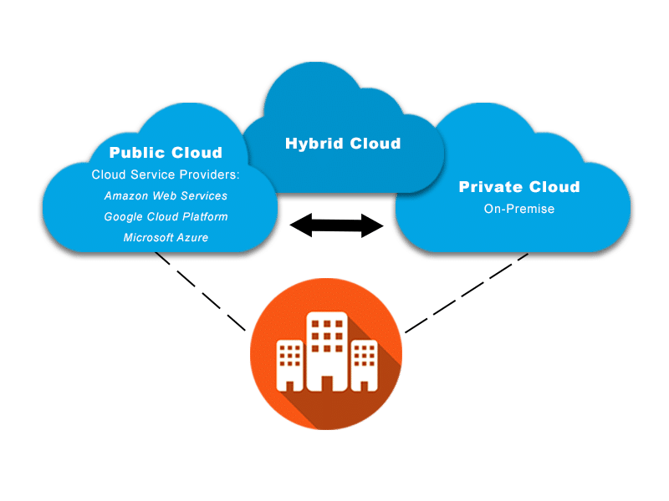
Public, Private,Hybrid

Slide 29

Advantages of Cloud Computing

Slide 30
Top Industrial Applications of Cloud Computing
1.Educational Institutions
2.Banking
3.Healthcare
4.Entertainment
5.Real Estate
6.Retail Industry
7.Automotive Industry

Slide 31
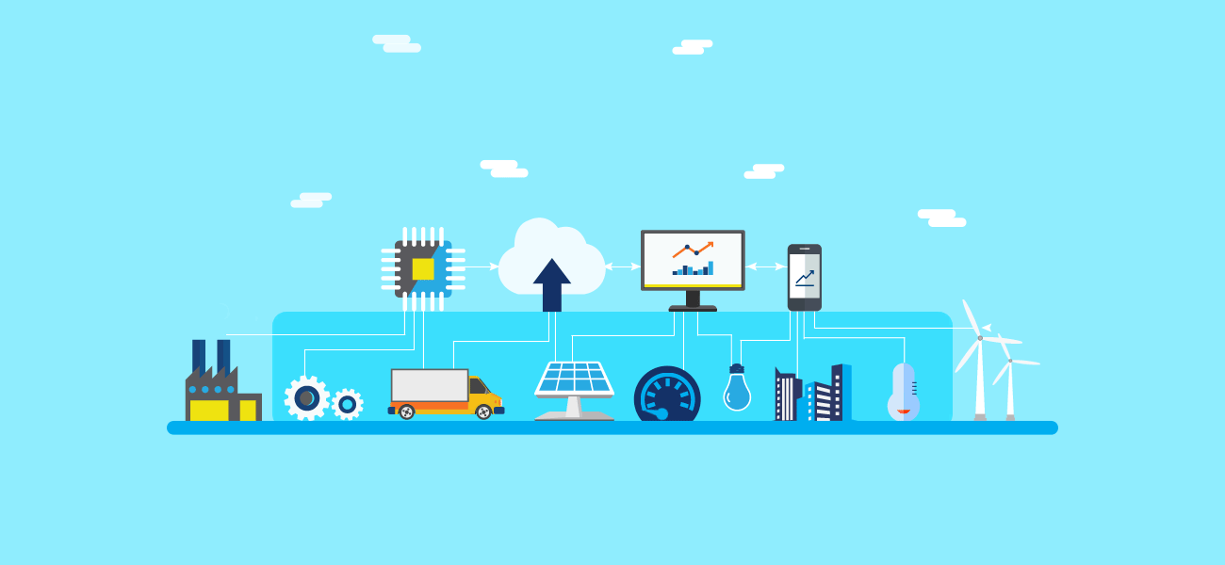

Slide 32
CapEx and OpEx
Capital expenditure:CapEx is defined as business expenses incurred in order to create long-term benefits in the future, such as purchasing fixed assets like a building or equipment.
Some examples of IT items that fall under this category would be whole systems and servers, printers and scanners, or air conditioners and generators.
You buy these items once and they benefit your business for many, many years.
Maintenance of such items is also considered CapEx, as it extends their lifetime and usefulness.

Slide 33
Operating expenditure
OpEx is your operating costs, the expenses to run day-to-day business, like services and consumable items that get used up and are paid for according to use.
This includes printer cartridges and paper, electricity, and even yearly services like website hosting or domain registrations.
These things are necessary for your business’s success but are not considered major long-term investments like CapEx items.

Slide 34
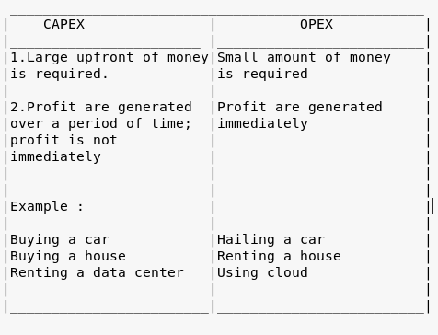
Capex vs opex

Slide 35
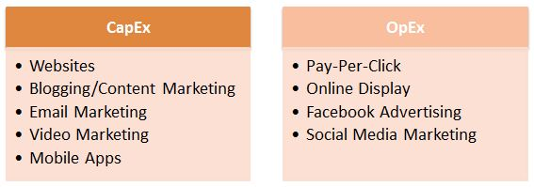
Examples

Slide 36
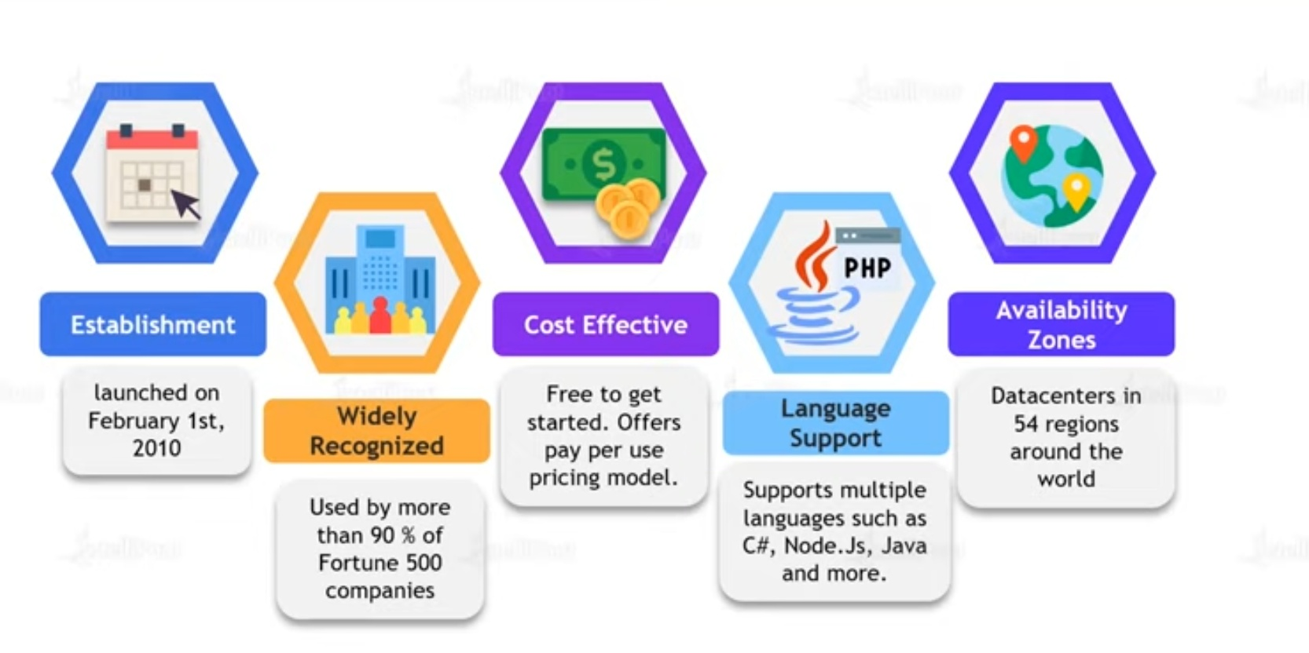
What is Microsoft azure

Slide 37

Advantages of MS Azure

Slide 38
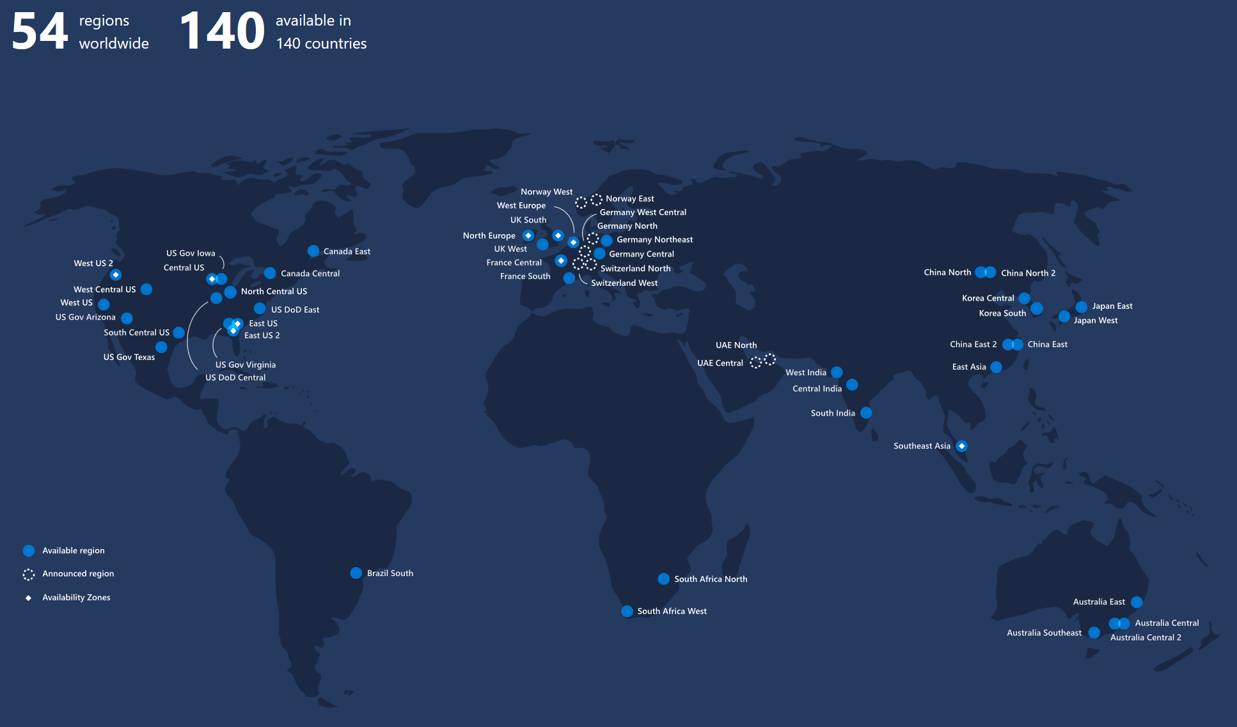
Azure Regions and Avalability zones

Slide 39
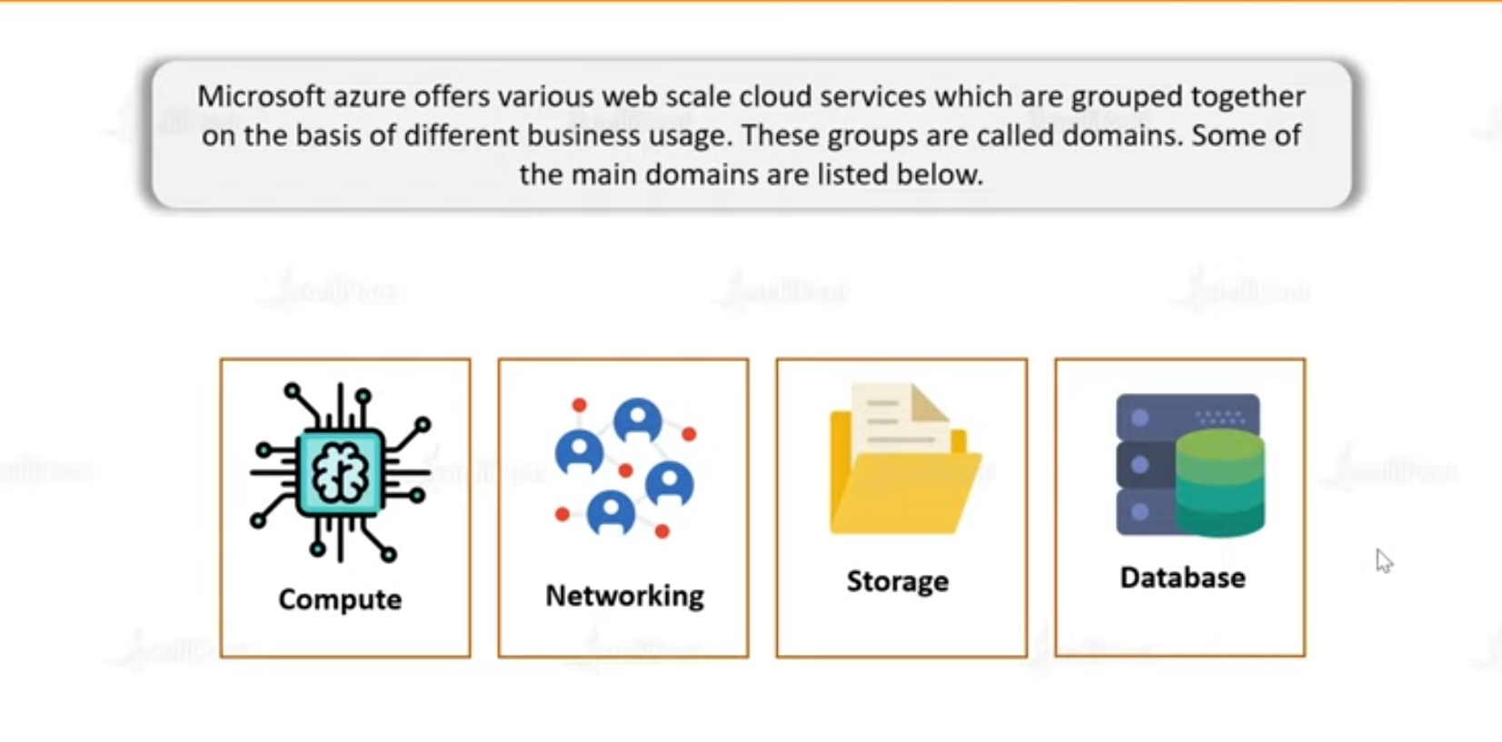
Microsoft Azure services

Slide 40
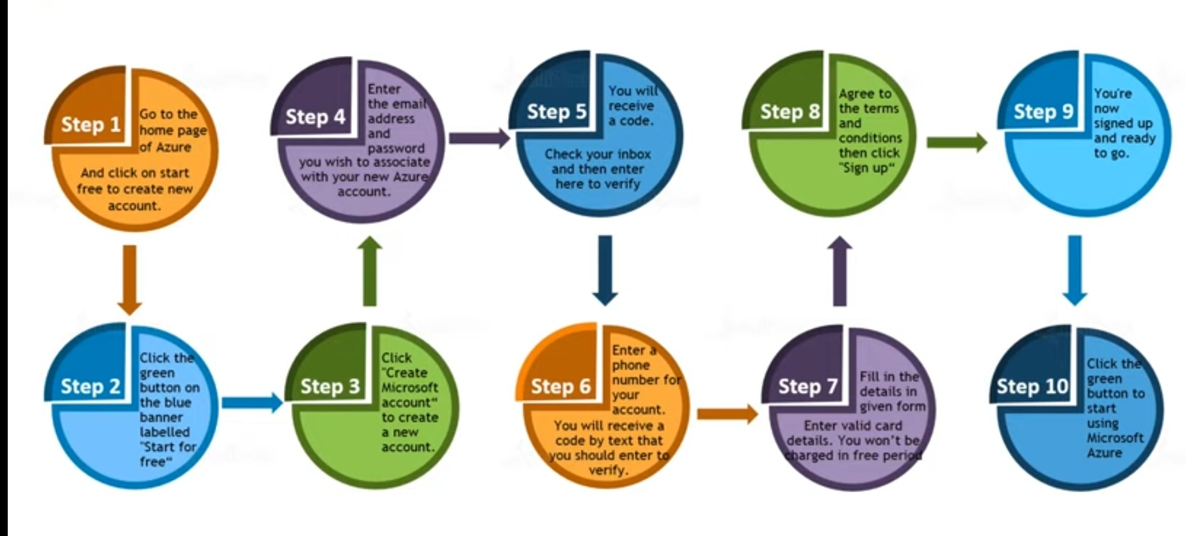
Creating Microsoft azure account

Slide 41
Create azure free account
Follow the steps
Go to browser and type Microsoft azure free account
or
Type http://portal.azure.com
Then fill the details for free subscription and login

Slide 42
Login and understanding the resources
Type your credentials to login to Microsoft azure
Then go to the portal
There are so many free services to use
Understand home page starting from menu
Followed by
Azure services
Navigate
Tools
See the portal menu in that there are so many options to learn lets see one by one but before that lets know something about azure portal in detail

Slide 43
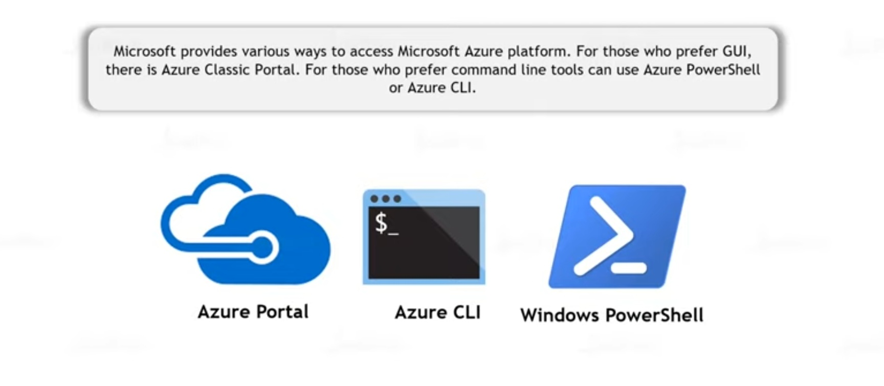
Ways of accessing Microsoft azure

Slide 44
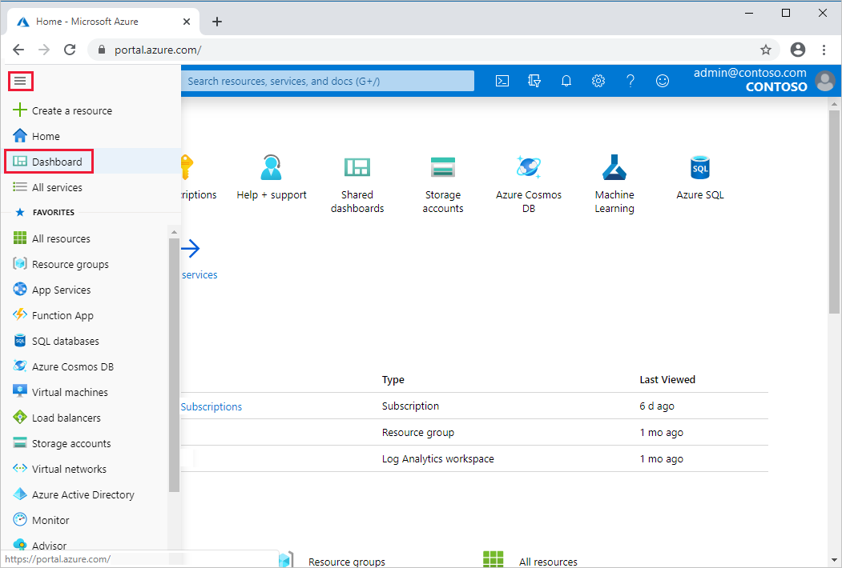
Azure portal

Slide 45
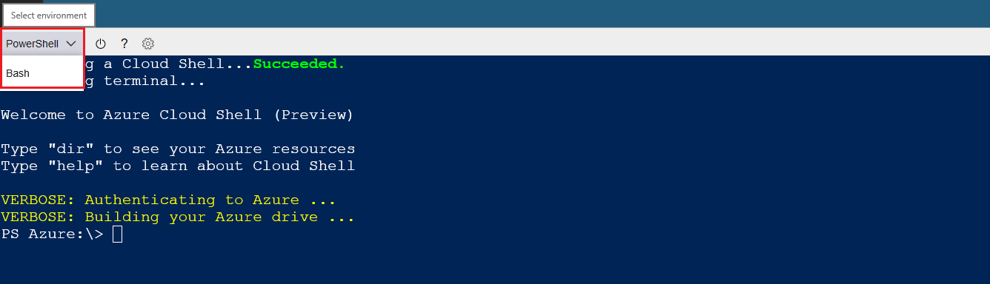
Azure powershell

Slide 46
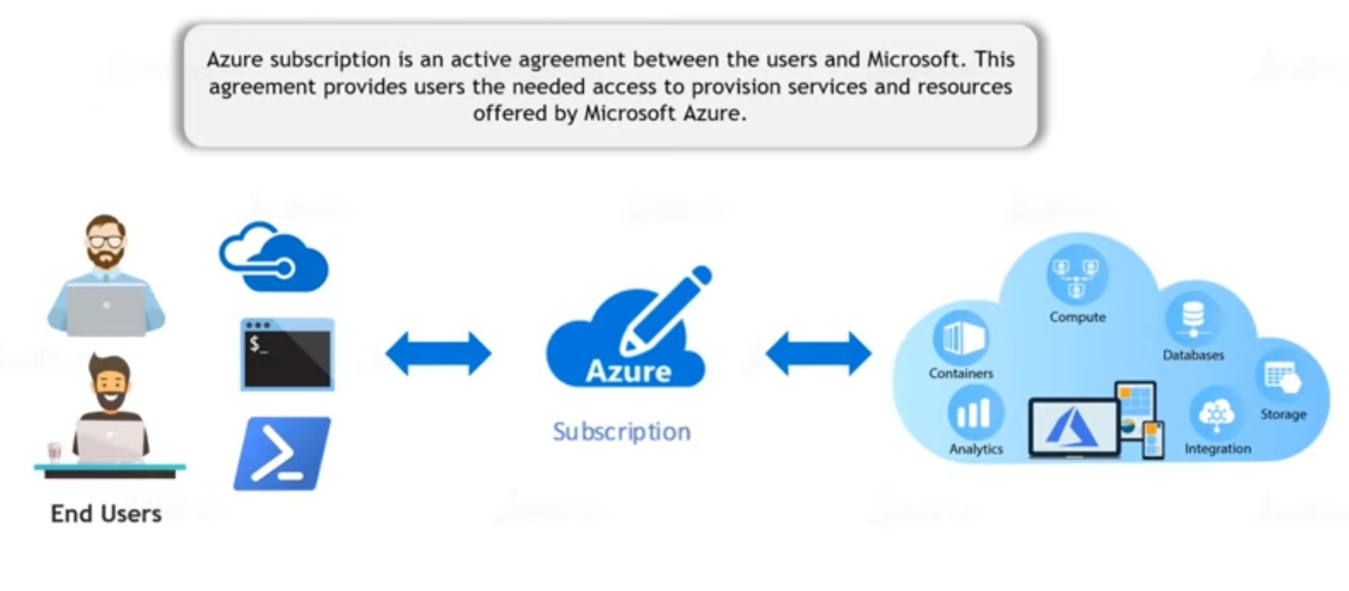
Azure subscriptions

Slide 47
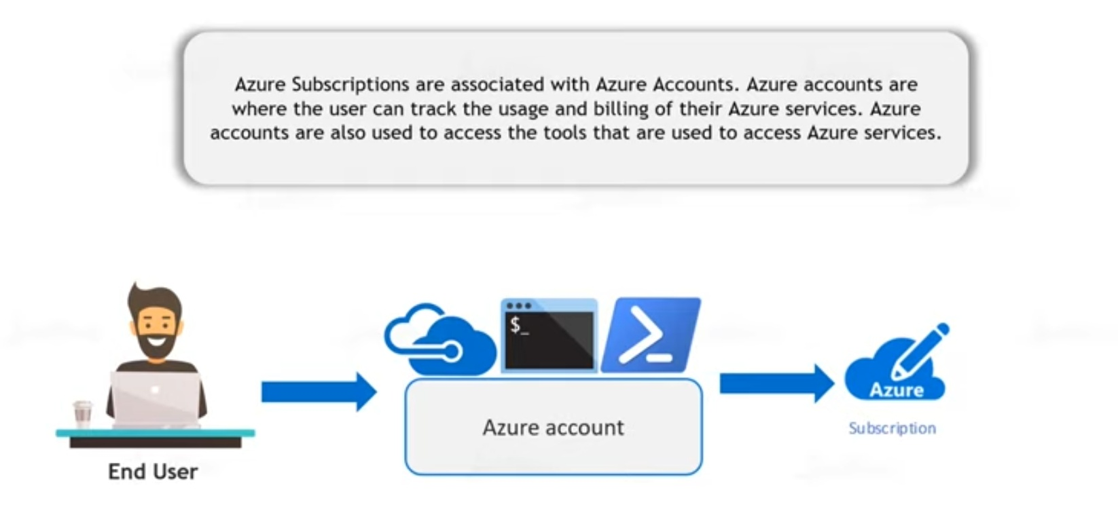

Slide 48
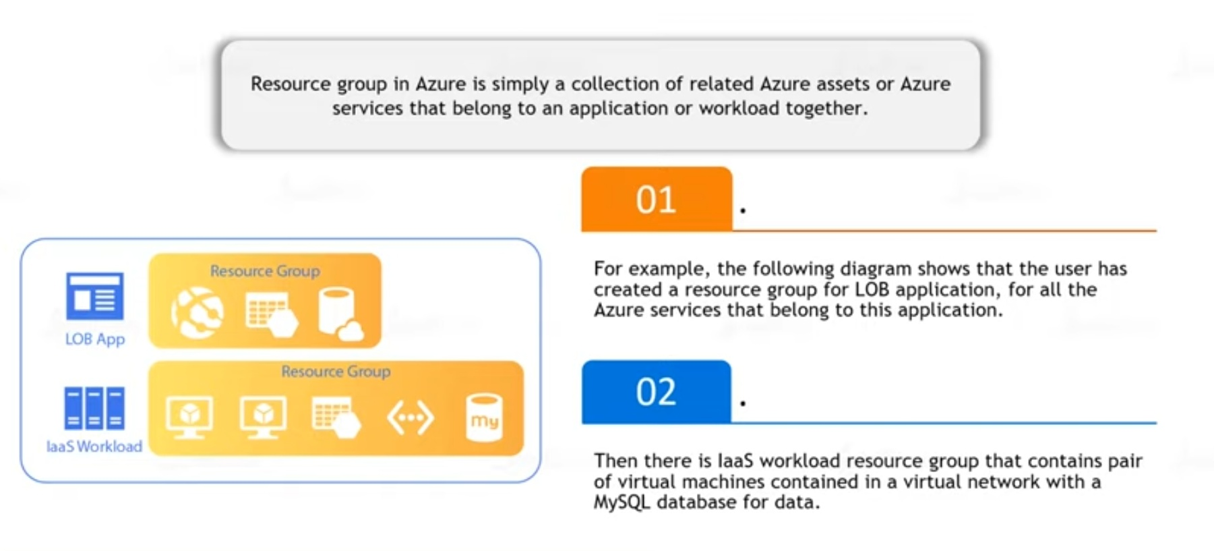
Azure Resource Groups

Slide 49
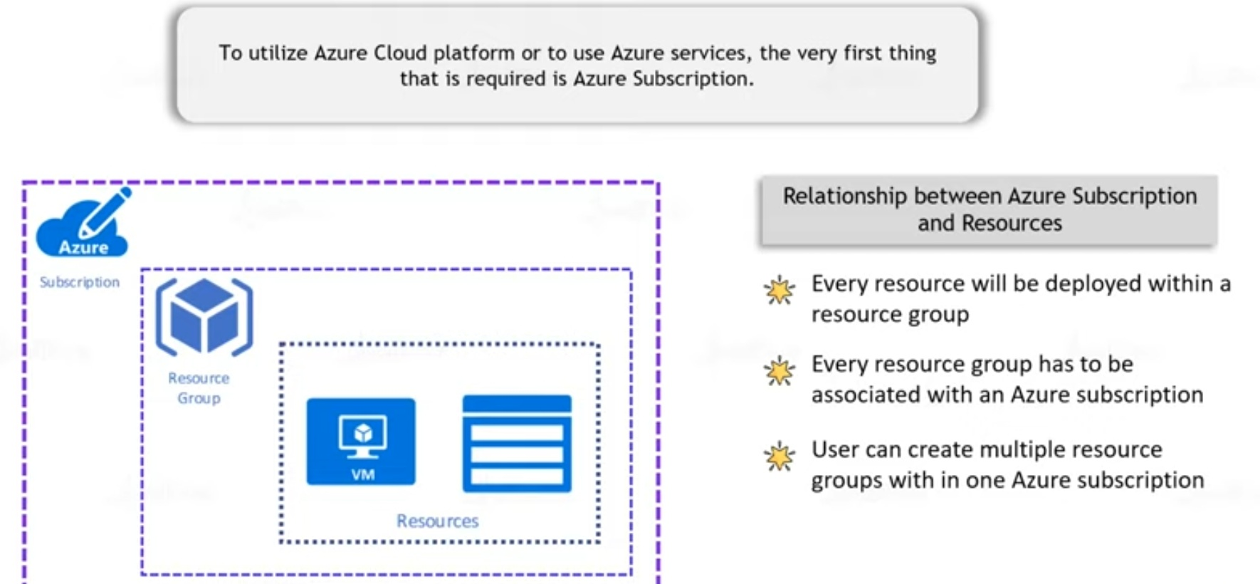
Azure Subscriptions and resources hierarchy

Slide 50
Resource group and resources
Resource groups: A resource group is a logical container into which Azure resources like web apps, databases, and storage accounts are deployed and managed.
Resources: Resources are instances of services that you create, like virtual machines, storage, or SQL databases.

Slide 51
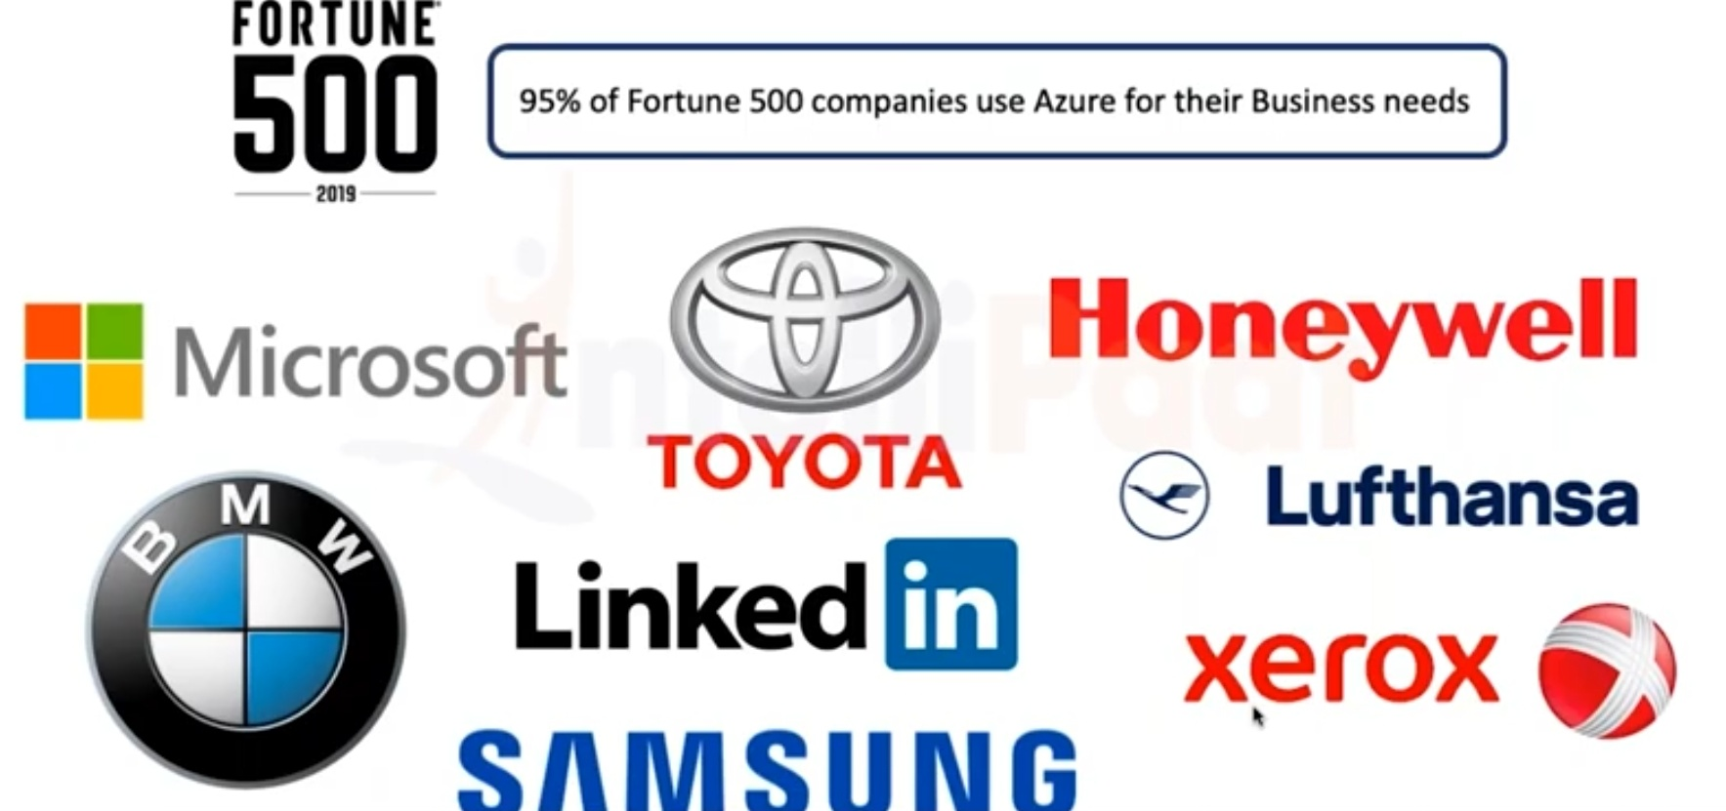
Companies who use Azure

Slide 52


Slide 53
Answers
Gmail is one famous example of an SaaS mail provider.
First of all, to answer the question in the title: Yes, Netflix is a SaaS company that sells software to watch licensed videos on demand. It follows a subscription-based model whereby the user chooses a subscription plan and pays a fixed sum of money to Netflix monthly or annually. SaaS is not a new concept.

